Slide 1
INFORMATION VISUALIZATION AND HISTORY: A PATH THROUGH TIME
Information Visualization in Humanities
23-24 March 2017
Torun, Poland
Alexandros Papadopoulos
Alexander Technological Education Institute of Thessaloniki

Slide 2
INFORMATION / DATA VISUALIZATION IN RETROSPECT

Slide 3
INFORMATION / DATA VISUALIZATION IN RETROSPECT
Some milestones:
1280 (Spain) – Paired comparisons diagram
1375 (Spain) – Catalan Atlas
1500 (N/A) – Rectangular coordinates (Leonardo da Vinci)
1570s (N/A) – First modern atlas, astral / planetary positions
1801 (N/A) – Pie chart
1962 (USA) – Modern statistical graphics
Source: http://www.datavis.ca/milestones

Slide 4
EMERGENCE OF MODERN INFORMATION VISUALIZATION
1800 - 1850
Modern graphics – First appearance
1850 - 1900
Statistical graphics – Golden Age
1900 - 1950
Modern dark times
1950 – 1975
InfoVis - Second wind
1975 – Present
InfoVis - Renaissance
Art or Science?
Source: A brief history of data visualization, M. Friendly, 2006

Slide 5
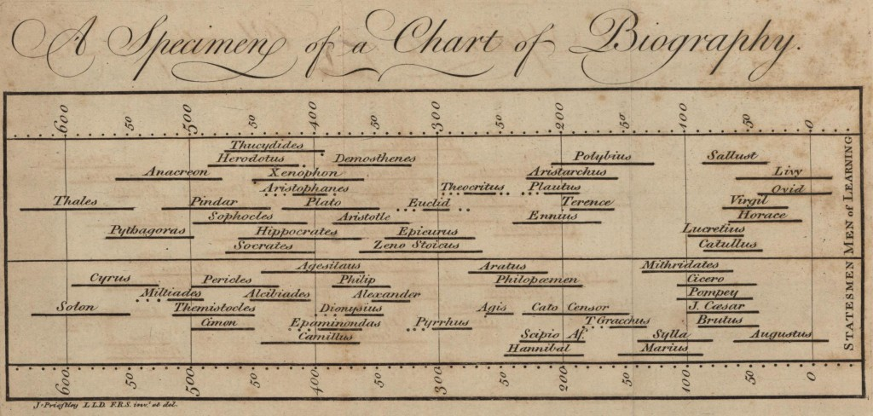
FRAGMENT OF JOSEPH PRIESTLY’S LIFE TIMELINE, 1765

Slide 6
INFORMATION VISUALIZATION IN THE 21ST CENTURY
What has changed:
New technology opens the way for innovations in the field of InfoVis.
Previous limitations are slowly being lifted.
InfoVis becomes more and more accessible.
Able to manage and present massive amounts of information.
Historical Events:
Discrete: Presented through generalized information
Description: Numeric/ textual
Descriptors: who, when, what, why
Data can be deciphered to provide further insight on the past

Slide 7
MUSEUMS
“To fulfill its purpose, a museum must present its content in a way that allows the public to see it. Additionally, it ought to help the average visitor to understand the meaning of their exhibits.”
(Gilman B.I., 1918)

Slide 8
MUSEUMS
Interpretation:
Educational activity which supports the practical, intellectual, emotional and aesthetic access to one's cultural heritage.
It doesn't incur on its own. Depends on the visitor's motives and the quality of the services offered by the museum.
Attemps to enrich one's understanding with something different, which leads to the personal satisfaction of the visitor.

Slide 9
INFORMATION VISUALIZATION IN MUSEUMS
Visualized information:
Memorized and digested much more effectively.
Possible access point for people who have no cognitive connection to a subject.
Formatted in an easier to understand way for vulnerable social groups.

Slide 10
EXAMPLE: WORLD WAR 2 CASUALTIES

Slide 11
CLOSING REMARKS – PERSONAL THOUGHTS
Information Visualization still hasn’t shown us its full potential. As technology evolves, it will keep surprising us.
InfoVis provides different benefits and opportunities to different target groups.
Museums must be both entertaining and educational to provide the most to their users. InfoVis is one of the methods that allow just that.

Slide 12
EPILOGUE
THANK YOU
Contact info:
Alexander Papadopoulos
alexandros.papadopoulos1000.gmail.com

